Slide 1
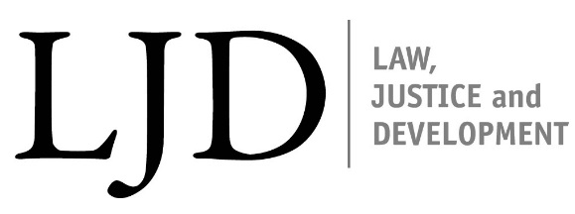
Law, Justice and Development Week 2013
Towards A Science of Delivery in Development
How Law and Justice Can Help Translate Voice, Social Contract and Accountability into Development Impact
November 11-15, 2013
1818 Street NW
Washington DC

